Slide 1
IBM University Engagement Project Submission
“Exploring the Power of Agentic AI with IBM Granite.”

Slide 2
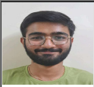
Project Tile – AgriSense AI
Domain of Project – Argiculture
Student Name | Recent Passport Photo | Email ID | Mobile number [WhatsApp]
Kunj Panara |  | kunjpanara412@gmail.com | 8320365048

Slide 3
Problem Statement - AI Agent for Smart Farming Advice
The Challenge
Farmers often struggle with low crop yield, unpredictable weather, pest infestations, and limited access to timely expert advice. Traditional farming advisory services are fragmented, slow, and not personalized to the farmer’s specific land, crop, or climate conditions. With the rise of climate change, data-driven smart farming solutions are needed to empower farmers with actionable insights.
The Objective
Develop an AI-powered Smart Farming Agent that provides personalized, real-time, and sustainable agricultural advice. The solution should:
Agricultural Knowledge Retrieval (RAG) – Use Retrieval-Augmented Generation to fetch best practices, crop-specific guidelines, and government advisory updates.
Weather & Soil Insights – Integrate real-time weather forecasts, soil health data, and irrigation needs to optimize farm planning.
Pest & Disease Detection – Enable multimodal support where farmers upload crop images for early pest/disease identification and get instant recommendations.
Personalized Advisory Agent – Suggest seeds, fertilizers, irrigation schedules, and harvesting timelines based on farmer profile and land conditions.
Market & Cost Optimization – Forecast demand, suggest market prices, and recommend cost-efficient practices for better income.
Multi-Agent Collaboration –
Crop Advisory Agent
Weather & Irrigation Agent
Pest/Disease Detection Agent
Market Insights Agent
Tech Stack (Mandatory)
IBM Langflow / IBM Orchestrate + IBM Models

Slide 4
Proposed Solution -
AgriSense AI is an AI-powered Smart Farming Assistant designed to help farmers make informed agricultural decisions through personalized, real-time recommendations. Built using IBM Granite, IBM watsonx.ai, IBM Langflow/Orchestrate, and Retrieval-Augmented Generation (RAG), the platform combines multiple AI agents for crop advisory, weather forecasting, pest and disease detection, irrigation planning, and market insights. Farmers can interact with the system in their preferred language using text or voice, upload crop images for instant disease diagnosis, and receive tailored recommendations based on their location, soil health, crop type, and weather conditions. By retrieving trusted agricultural knowledge from government advisories and combining it with live weather and market data, AgriSense AI provides accurate, context-aware guidance that improves crop yield, reduces farming costs, promotes sustainable practices, and helps farmers maximize their income through intelligent, data-driven decision-making.

Slide 5
Technology Used
IBM Granite Model (e.g., IBM Granite 3.2 8B) – Used for natural language understanding, multilingual conversations, reasoning, and personalized farming recommendations. It analyzes farmer queries and provides intelligent advice on crop selection, irrigation, fertilizer usage, pest management, harvesting schedules, and government schemes.
IBM Cloud – Provides the secure, reliable, and scalable infrastructure to build, deploy, and manage the AgriSense AI platform. IBM Cloud hosts the AI services, APIs, databases, and application, ensuring high availability and seamless scalability.
Retrieval-Augmented Generation (RAG) – Retrieves real-time agricultural knowledge from trusted sources such as ICAR guidelines, government advisories, weather updates, crop management documents, and agricultural schemes before generating responses. This makes the AI assistant more accurate, trustworthy, and up to date.
IBM Watsonx.ai – Used for AI model deployment, prompt engineering, embeddings, model management, and AI governance. It powers the intelligent recommendation engine and enables secure, responsible AI throughout the platform.
Vector Database (FAISS/ChromaDB) – Stores vector embeddings of agricultural documents, crop guides, pest and disease information, government schemes, and farming best practices. It enables fast semantic search for the RAG pipeline, ensuring highly relevant and context-aware responses to farmer queries.

Slide 6

Role of Agentic AI in the solution
Role of Agentic AI in AgriSense AI – Smart Farming Agent
Agentic AI enables AgriSense AI to function as an intelligent, autonomous farming assistant rather than a simple chatbot. Using IBM watsonx.ai, IBM Granite models, and IBM Orchestrate/Langflow, it coordinates multiple specialized AI agents to provide personalized, real-time farming recommendations.
Each AI agent is responsible for a specific task while collaborating with the others to deliver accurate and actionable insights:
Crop Advisory Agent recommends suitable crops, seeds, fertilizers, and harvesting schedules based on the farmer's location, soil type, season, and farm profile.
Weather & Irrigation Agent retrieves real-time weather forecasts and predicts irrigation requirements to help farmers optimize water usage and protect crops from adverse weather conditions.
Pest & Disease Detection Agent analyzes uploaded crop images using AI to identify pests and diseases, assess severity, and recommend appropriate treatments and preventive measures.
Market Insights Agent monitors live market prices, demand trends, and mandi data to suggest the best time and place to sell crops for maximum profit.
Agentic AI provides context-aware recommendations by understanding the farmer's crop type, land size, soil health, weather conditions, farming history, and preferred language. This enables highly personalized advice instead of generic agricultural recommendations.
The system also supports real-time adaptation, continuously updating recommendations whenever weather forecasts change, new pest outbreaks are detected, or market prices fluctuate.
Through seamless communication between all specialized agents, AgriSense AI combines weather intelligence, crop knowledge, disease detection, and market analysis into a single, comprehensive recommendation, enabling smarter and more informed farming decisions.
Overall, Agentic AI transforms AgriSense AI into a proactive, intelligent, and personalized digital farming assistant that helps farmers improve crop yield, reduce operational costs, minimize risks, and increase profitability while promoting sustainable agricultural practices.

Slide 7
Novelty and Uniqueness
Novelty and Uniqueness
The proposed AgriSense AI – Smart Farming Agent stands out by combining Agentic AI, Retrieval-Augmented Generation (RAG), multimodal AI, and real-time agricultural intelligence into a single intelligent farming platform.
Multi-Agent Intelligence – Instead of relying on a single chatbot, multiple specialized AI agents collaborate to provide personalized crop advisory, weather forecasting, pest and disease detection, irrigation planning, and market insights.
RAG-Based Agricultural Knowledge – Retrieves the latest farming guidelines, government advisories, crop management practices, and agricultural schemes before generating responses, ensuring accurate, trustworthy, and up-to-date recommendations.
Hyper-Personalized Farming Advice – Generates recommendations based on the farmer's location, soil health, crop type, land size, weather conditions, and farming history, making every suggestion relevant to individual farm needs.
Real-Time Decision Support – Continuously updates recommendations using live weather forecasts, soil information, pest alerts, and market price fluctuations to help farmers make timely decisions.
Multimodal Interaction – Supports text, voice, and image inputs, allowing farmers to ask questions in their preferred language, upload crop images for disease detection, and receive voice-enabled recommendations.
Farmer-Friendly Accessibility – Offers multilingual support, voice assistance, and a simple user interface designed for farmers with varying levels of digital literacy.
Sustainable & Cost-Optimized Farming – Recommends efficient irrigation schedules, fertilizer usage, and cost-effective farming practices to improve productivity while conserving natural resources.
Enterprise-Ready & Scalable – Built on IBM Granite, IBM watsonx.ai, IBM Langflow/Orchestrate, and IBM Cloud, ensuring secure, scalable, and responsible AI deployment.
This makes AgriSense AI a proactive, intelligent, and personalized digital farming companion that goes beyond traditional advisory systems by delivering real-time, data-driven insights to improve crop yield, reduce risks, and maximize farmers' income.

Slide 8
Git Hub Link
https://github.com/kunj2006-05/AgriSense-AI-IMB-project-
·
·
·

Slide 9
Future Scope
1.IoT & Smart Farming Sensor Integration – The system can be integrated with IoT devices such as soil moisture sensors, weather stations, drones, and smart irrigation systems to collect real-time farm data. This will enable AgriSense AI to provide more precise recommendations for irrigation, fertilizer application, crop health monitoring, and resource optimization based on live field conditions.
2. AI-Powered Voice Assistant & Multilingual Support – AgriSense AI can be enhanced with a voice-enabled assistant supporting multiple regional languages such as Hindi, Gujarati, Marathi, Punjabi, Tamil, Telugu, and Kannada. Farmers will be able to interact with the system through voice commands and receive spoken recommendations, making the platform more accessible for users with limited literacy and improving adoption across rural communities.
·
·
·

Slide 10
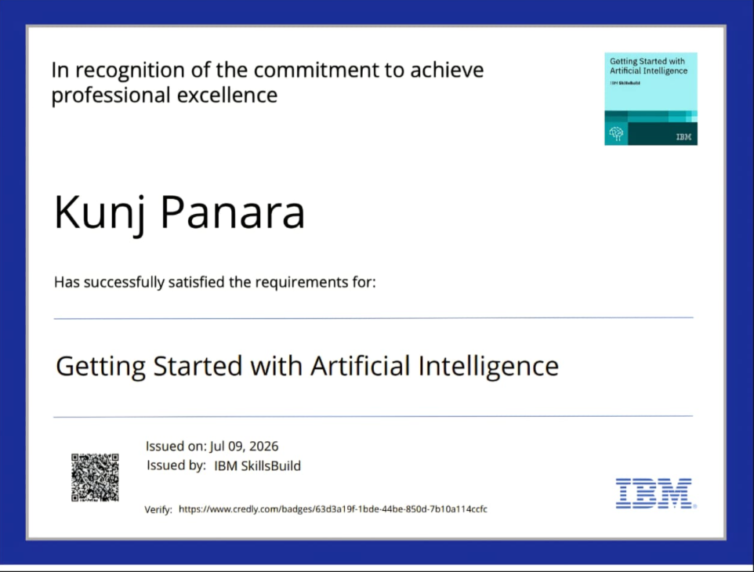
Certificates Earned:

Slide 11
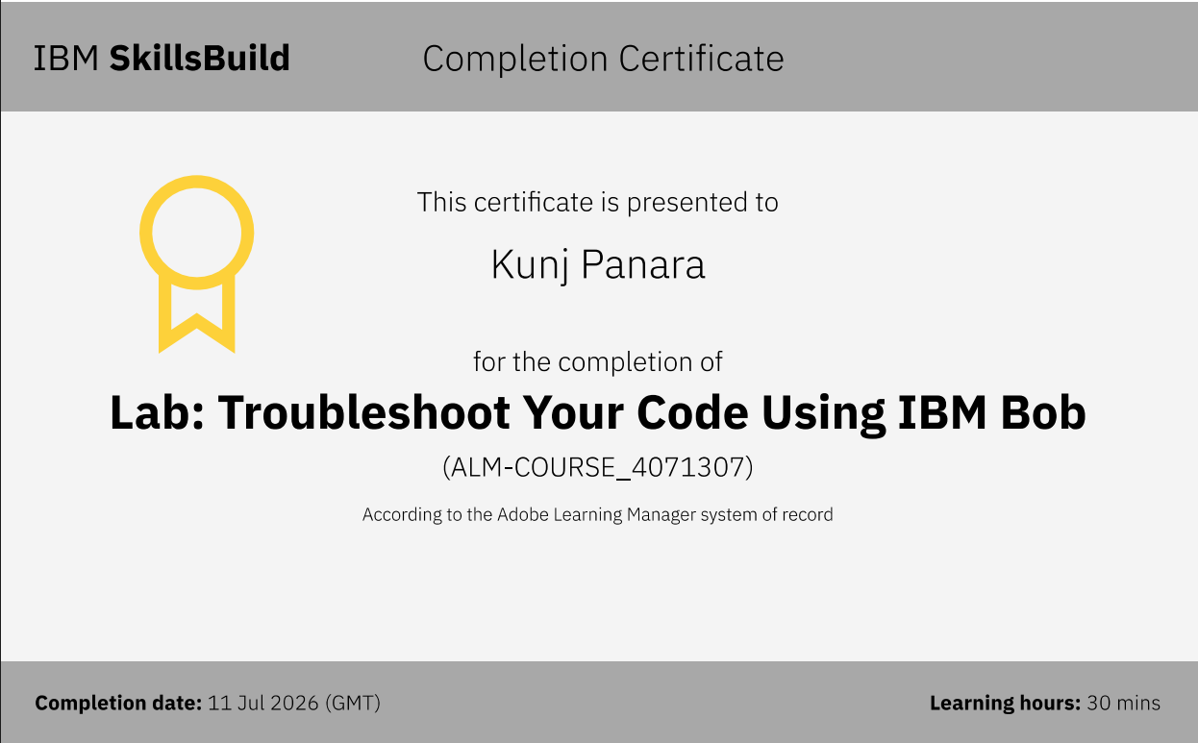
Certificates Earned:​

Slide 12
THANK YOU!

